Slide 1

Action Language for Foundational UML (Alf)
Joint submission of a
Concrete Syntax for a UML Action Language
Alf

Slide 2





Submitters
Model Driven Solutions
Mentor Graphics
88solutions Corporation
No Magic
Visumpoint

Slide 3
Agenda
Purpose and Scope
Design Principles
Issues To Be Discussed
Examples

Slide 4
Purpose and Scope
From the RFP:
“This request therefore solicits proposals for a concrete syntax for a textual UML Action Language for the action model incorporated into fUML that will operate only at the level of abstraction of UML and which is capable of being translated into different implementations for different platforms and languages.”
“The scope of the action language is the action model of the Executable UML Foundation, including the standard model libraries for I/O and basic operations.”
“Proposals may incorporate constructs for other elements in the Executable UML Foundation that are not part of the action model, if desired.”

Slide 5
Purpose and Scope (continued)
From the RFP:
Consider this fragment of pseudo-code that iterates over a list:
nextCall := CallListHead; totalTime := 0;
While (nextCall != Null) do
nextCall := nextCall.next;
totalTime += nextCall.minutes;
endWhile
UML doesn’t specify linked lists; it’s an implementation choice. What happens when the data structure changes? Much of this logic must be modified.
Using [Alf] we could instead write:
totalTime = #'+'(Call.allinstances().minutes);
which finds all the instances of Call, accesses its attribute minutes, uses [a reduce operation] to add them all, and then [provides a loca name for] the value. The data structure is expressed abstractly, at the level of UML, and can be translated to any implementation. Such an abstract language can be translated into multiple different implementations, including even hardware.

Slide 6
Purpose and Scope (continued)
However:
In Alf, if you want, you can also write:
nextCall = CallListHead;
totalTime = 0;
while (nextCall != null){
nextCall = nextCall.next;
totalTime += nextCall.minutes;
}
if you have explicitly modeled call lists, etc.

Slide 7
Design Principles for Alf
A familiar C-legacy (“Java like”) syntax, but with UML textual syntax when it exists .
Minimizing the need for graphical models to change in order to accommodate use of the action language.
Usable in context of models not limited to the fUML subset.
Consistency of language units, however and wherever they are attached to the wider model.
A naming system that is based on UML namespaces for referencing elements outside of an activity and a consistent use of names to reference nodes within an activity.
An implicit type system based on typing declared in the structural model elements.
The expressivity of OCL in the use and manipulation of collections.
Concrete syntax for structural modeling (largely within the bounds of the fUML subset).

Slide 8
Issues in Using fUML
fUML has higher level constructs than typical target implementation languages, but still lacks some features, e.g.:
  Static features
  Exceptions
Integration into graphical models requires semantics outside the fUML subset, e.g.:
  Triggers on state machines
  Invocation through ports

Slide 9
Issues to be Discussed
Proposals shall discuss the relationship of the concrete syntax to existing OMG language specifications, particularly OCL.
  Uses relevant UML 2 textual notation (e.g., “::” for namespace scoping, “name: type” for typing, bracket notation for multiplicity, etc.)
  Use OCL-like notation for collection operations
Proposals shall discuss how they resolved the tension between the perceived marketability of imperative languages and both OCL and the data-flow nature of the action model.
  The overall Java-like, C-legacy syntax is very familiar, and can be used in an imperative way
  The OCL-like syntax is smoothly integrated and allows for concurrent, data-flow-oriented expressions
  “Local names” within activity code look largely like variables, but are references to them are mapped to object flows

Slide 10
Issues to be Discussed (continued)
Proposals shall discuss the relationship to formal specification languages and how an action language “program” may be proven
  OCL declarative specifications can be used as the basis for Alf executable specifications
  Alf maps semantically to fUML, which has a formal semantic foundation
Proposals shall discuss the ease of use and understandability from the point of view of the modeler.
  Syntax is familiar to the programming-language mainstream
  Common UML textual notations are familiar to the modeler
  Syntax supports underlying UML model semantics
Proposals shall discuss the parsability of the language (e.g. LL1, LALR).
  LL(n) parser implemented using JavaCC technology
  Mostly LL(1), but currently requires n=2 or greater in some areas

Slide 11
Conformance
Syntactic Conformance
Complete Alf. Complete Alf syntax, including structural modeling (“modeling language”)
Basic Alf. Excludes structural modeling (“action language”)
Simplified Alf. Subset consistent with capabilities of a traditional procedural programming language (“snippet language”)
Semantic Conformance
Interpretive Execution. Direct interpretation
Compilative Execution. Compilation to fUML
Translational Execution. Translation to non-UML target platform

Slide 12
Example 1: run Operation
Java Version
/**
Run the given node activations and then (concurrently) send an offer to
all activations for nodes with no incoming edges within the given set.
*/
void run(Set<ActivityNodeActivation> activations) {
for (ActivityNodeActivation activation: activations) {
activation.run();
}
Collection<ActivityNodeActivation> enabledActivations =
new ArrayList<ActivityNodeActivation>();
for (ActivityNodeActivation activation: activations) {
boolean isEnabled =
activation instanceof ActionActivation &&
((Action)activation.node).input.size() == 0 ||
activation instanceof ControlNodeActivation ||
activation instanceof ActivityParameterNodeActivation;
if (isEnabled) {
search:
for (ActivityEdgeInstance incomingEdge: activation.incomingEdges) {
for (ActivityNodeActivation otherActivation: activations) {
if (otherActivation.isSourceFor(incomingEdge)) {
isEnabled = false;
break search;
}
}
}
if (isEnabled) {
enabledActivations.add(activation);
}
}
}
// *** Send offers to all enabled nodes concurrently. ***
for (ActivityNodeActivation enabledActivation: enabledActivations) {
(new Thread(new OfferSender(enabledActivation))).start();
}

Slide 13
Example 1: run Operation
“Java-like” Alf Version
namespace fUML::Semantics::Activities::IntermediateActivities::
ActivityNodeActivationGroup;
/**
Run the given node activations and then (concurrently) send an offer to
all activations for nodes with no incoming edges within the given set.
*/
activity run(in activations: Set<ActivityNodeActivation>) {
for (activation in activations) {
activation.run();
}
enabledActivations = ActivityNodeActivation[]{};
for (activation in activations) {
isEnabled =
activation instanceof ActionActivation &&
((Action)activation.node).input -> size() != 0 ||
activation instanceof ControlNodeActivation ||
activation instanceof ActivityParameterNodeActivation;
for (incomingEdge in activation.incomingEdges while isEnabled) {
for (otherActivation in Activations while isEnabled) {
if (otherActivation.isSourceFor(incomingEdge)) {
isEnabled = false;
}
}
}
if (isEnabled) {
enabledActivations -> add(activation);
}
}
// *** Send offers to all enabled nodes concurrently. ***
@parallel
for (enabledActivation in enabledActivations) {
enabledActivation.receiveOffer();
}
}

Slide 14
Example 1: run Operation
OCL 2.0 Specification
context ActivityNodeActivationGroup::run(activations: Set(ActivityNodeActivation))
post:
activations->forAll(activation | activation^^run()->size() = 1) and
let enabledActivations: Set(ActivityNodeActivation) =
activations -> select(
(oclIsKindOf(ActionActivation) and
node.oclAsType(Action).input -> notEmpty() or
oclIsKindOf(ControlNodeActivation) or
oclIsKindOf(ActivityParameterNodeActivation) and
not incomingEdges -> exists incomingEdge (
activations -> exists(isSourceFor(incomingEdge)
)
)
in enabledActivations -> forAll(enabledActivation |
enabledActivation^^receiveOffer()->size() = 1
)

Slide 15
Example 1: run Operation
“OCL-like” Alf
namespace fUML::Semantics::Activities::IntermediateActivities::
ActivityNodeActivationGroup;
/**
Run the given node activations and then (concurrently) send an offer to
all activations for nodes with no incoming edges within the given set.
*/
activity run(in activations: ActivityNodeActivation[*]) {
activations -> iterate activation (activation.run());
enabledActivations = activations -> select activation (
(activation instanceof ActionActivation &&
((Action)activation.node).input -> notEmpty() ||
activation instanceof ControlNodeActivation ||
activation instanceof ActivityParameterNodeActivation) &&
!activation.incomingEdges -> exists incomingEdge (
activations -> exists otherActivation (
otherActivation.isSourceFor(incomingEdge)
)
)
);
// *** Send offers to all enabled nodes concurrently. ***
enabledActivations.receiveOffer();
}

Slide 16
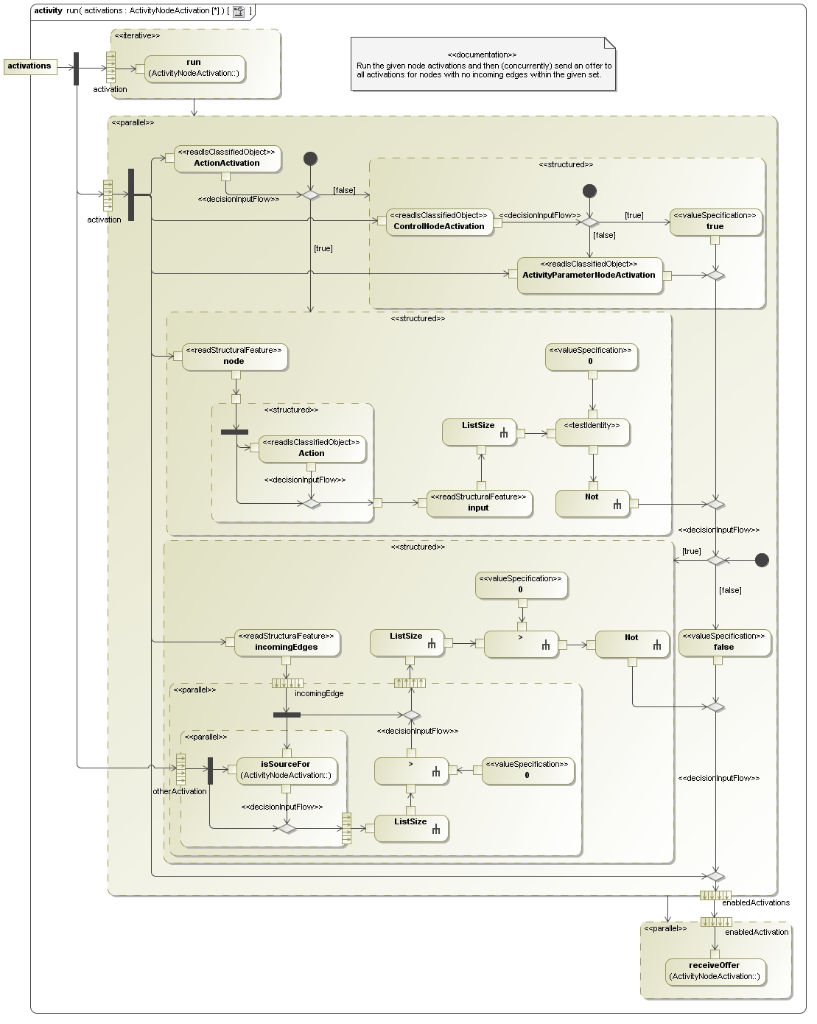
Example 1: run Operation
Activity Diagram

Slide 17
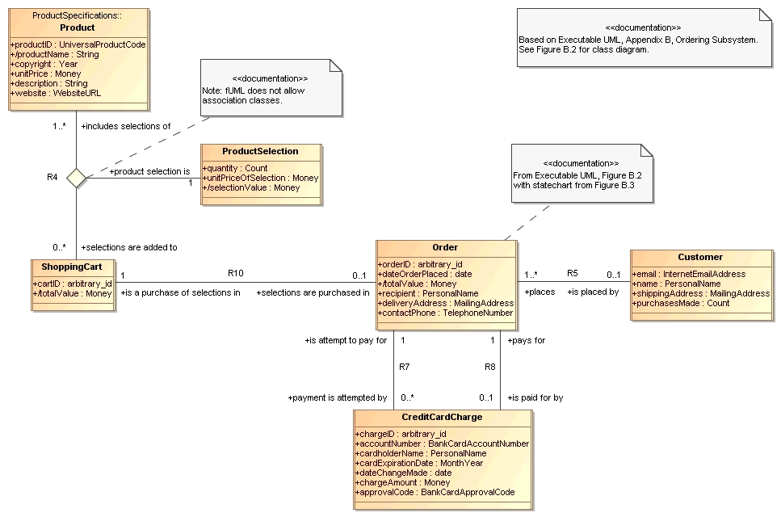
Example 2: Online Bookstore
Ordering Subsystem

Slide 18
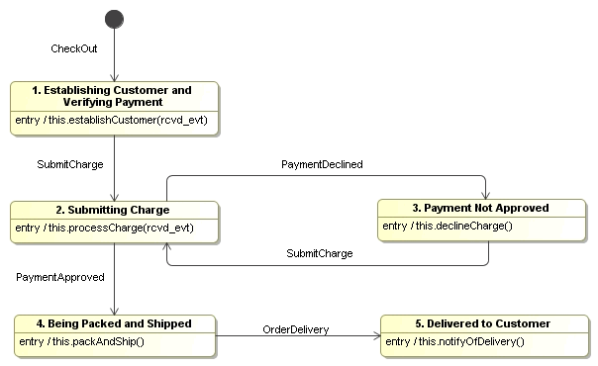
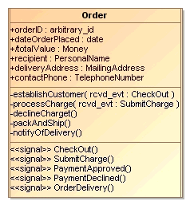
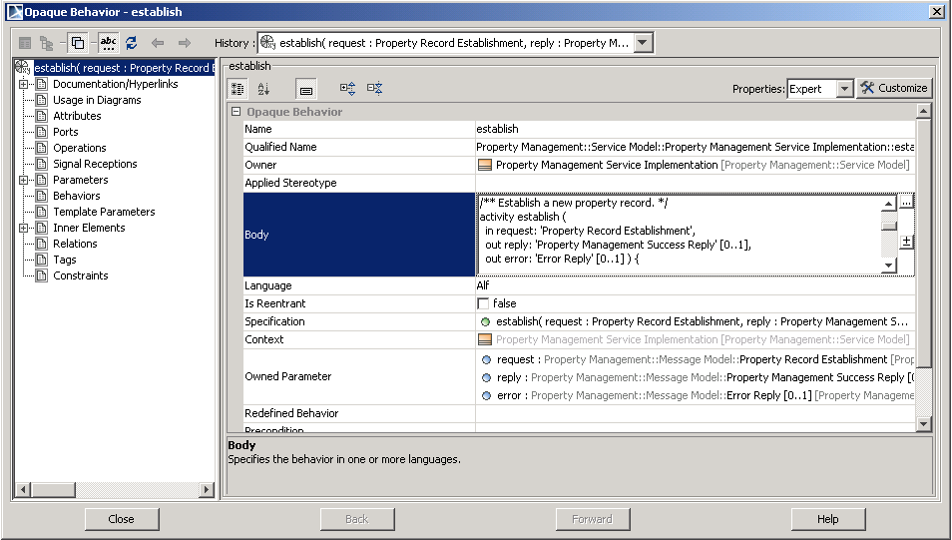
Example 2: Online Bookstore
Order Class

Slide 19
Example 2: Online Bookstore establishCustomer Operation
namespace Ordering::Order;
private import TIM;
/**
From Executable UML, Figure B.3, entry behavior for
Establishing Customer and Verifying Payment
*/
activity establishCustomer(in rcvd_evt: CheckOut) {
R10 -> add (
'selections are purchased in' => this,
'is a purchase of selections in' => rcvd_evt.cart
);
matchingCustomers = Customer -> select c (c.email == rcvd_evt.customerEmail);
if (matchingCustomers->isEmpty()) {
customer = new Customer();
customer.email = rcvd_evt.customerEmail;
} else {
customer = matchingCustomers[1];
}
customer.name = rcvd_evt.customerName;
customer.shippingAddress = rcvd_evt.shippingAddress;
customer.phone = rcvd_evt.customerPhone;
R5 -> add (
places => this,
'is placed by' => customer
);
this.dateOrderPlaced = TIM::current_date;
this.SubmitCharge(
accountNumber => rcvd_evt.accountNumber,
billingAddress => rcvd_evt.billingAddress,
cardExpirationDate => rcvd_evt.cardExpirationDate,
cardholderName => rcvd_evt.cardholderName);
}

Slide 20
Example 2: Online Bookstore
Order Class – Alf Version
namespace Ordering;
/**
From Executable UML, Figure B.2, with statechart from Figure B.3
*/
active class Order
{
public orderID: arbitrary_id;
public dateOrderPlaced: date;
public totalValue: Money;
public recipient: PersonalName;
public deliveryAddress: MailingAddress;
public contactPhone: TelephoneNumber;
public receive signal CheckOut;
public receive signal SubmitCharge;
public receive signal PaymentDeclined{}
public receive signal PaymentApproved{}
public receive signal OrderDelivered{}
private establishCustomer(in rcvd_evt: CheckOut);
private processCharge(in rcvd_evt: SubmitCharge);
private declineCharge();
private packAndShip();
private notifyOfDelivery();
} do
…

Slide 21
Example 2: Online Bookstore
Order Class – Alf Version (continued)
{
/** 1. Establishing Customer and Verifying Payment */
accept (checkOut: CheckOut);
this.EstablishCustomer(checkOut);
do {
/** 2. Submitting Charge */
accept (chargeSubmission: SubmitCharge);
this.ProcessCharge(chargeSubmission);
accept (PaymentDeclined) {
declined = true;
/** 3. Payment Not Approved */
this.DeclineCharge();
} or accept (PaymentApproved) {
declined = false;
}
} while (declined);
/** 4. Being Packed and Shipped */
this.PackAndShip();
/** 5. Delivered to Customer */
accept(OrderDelivery);
this.NotifyOfDelivery();
}

Slide 22
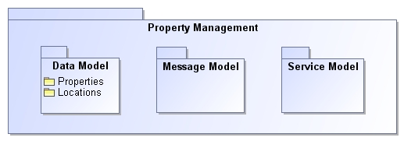
Example 3: Property Management Service

Slide 23
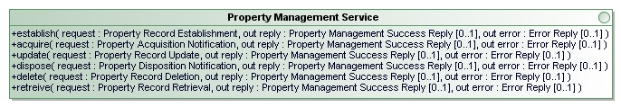
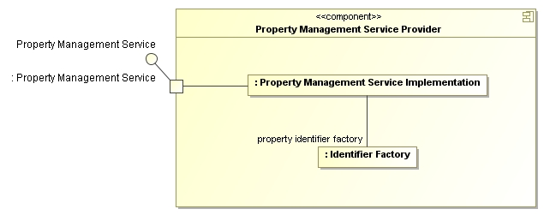
Example 3: Property Management Service
Service Model

Slide 24
Example 3: Property Management Service establish Operation
namespace 'Property Management'::'Service Model'::
'Property Management Service Implementation';
private import 'Property Management'::'Data Model'::Properties::*;
private import 'Property Management'::'Message Model'::*;
/** Establish a new property record. */
activity establish (
in request: 'Property Record Establishment',
out reply: 'Property Management Success Reply' [0..1],
out error: 'Error Reply' [0..1] ) {
identifier = this.'property identifier factory'.'get next identifier'();
if (request.'property type' == 'Property Type'::personal) {
property = new 'Personal Property'::'create property'(identifier, request.name);
} else {
property = new 'Real Property'::'create property'(identifier, request.name);
}
reply = this.'create reply'(request.identifier, property);
}

Slide 25
Demonstration
Alf Reference Implementation
http://lib.modeldriven.org/MDLibrary/trunk/Applications/Alf-Reference-Implementation/
activity Hello() {
WriteLine("Hello World!");
}
namespace ::FoundationalModelLibrary;
package BasicInputOutput {
…
public activity WriteLine(in value: String, out errorStatus: Status[0..1]) {
StandardOutputChannel.allInstances().writeLine(value, errorStatus);
}
}

